Slide 1
UafA Project Update
180613 Changhua Yu

Slide 2
Overview
Better visualization on superimposition between annotated regions and mutated sites
Generate the overlapping of all the mutated sites with each of the functional region
Finish the labelling of func region in Pymol: As the Pymol display a label for each of the selected residues atoms, use a color scheme table instead
Generate useful statistics from the sqlite3 outputs for the functional predictions
Generate tables to answer: which site, AA change, site-AA pair and which region has the most frequent change
Output a correlation count matrix with a side length of N (N is the number of all distinct AA- site pairs)
Visualize spatial relationship of the mutated sites

Slide 3
Overview
Structural prediction on N1 Region by online servers:
I-TASSER
Phyre2--homologous
Robbeta -- direct folded, only good for the shorter sequences ,N1 only e.g
Pfam -- alignment based prediction
Research more on the prediction tool relating to single amino acid mutagenesis
Literature on bioinformatics tools for AAS prediction
summary of computational servers for use
Notes:
Tools: protein stability etc ..

Slide 4
Code Documentation
Superimpose.SuperimposeEachRegion: Export 5 pymol sessions with the overall mutated sites overlap with each of the functional regions, with the GetMutatedSites only as blue, functional region only as green and overlapping region as red
SimpleCorrMatrix: Export a list, with each element a tuple of 5 elements: first_mute_site, first_mute_AA, second_mute_site, second_mute_AA, corr_count
WriteHapFuncMap: Build the sqlite table hap_func_match
WriteMuteCount: Build the sqlite table mute_count
WriteMuteSpecificCount: Build the sqlite table mute_specific_count

Slide 5
Visualization

Slide 6
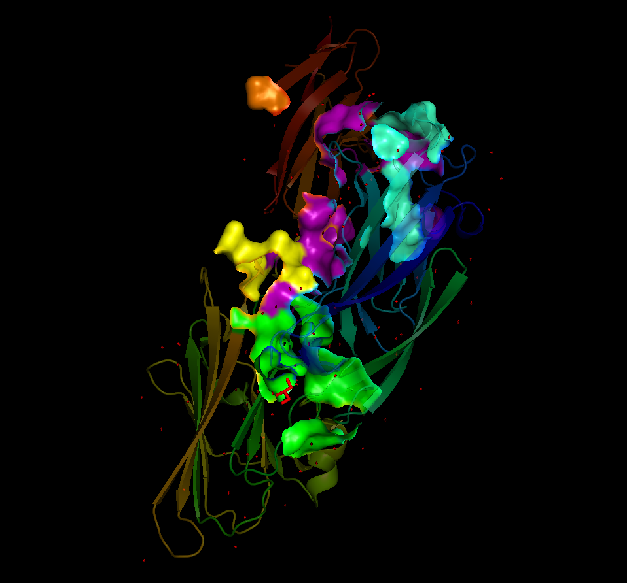
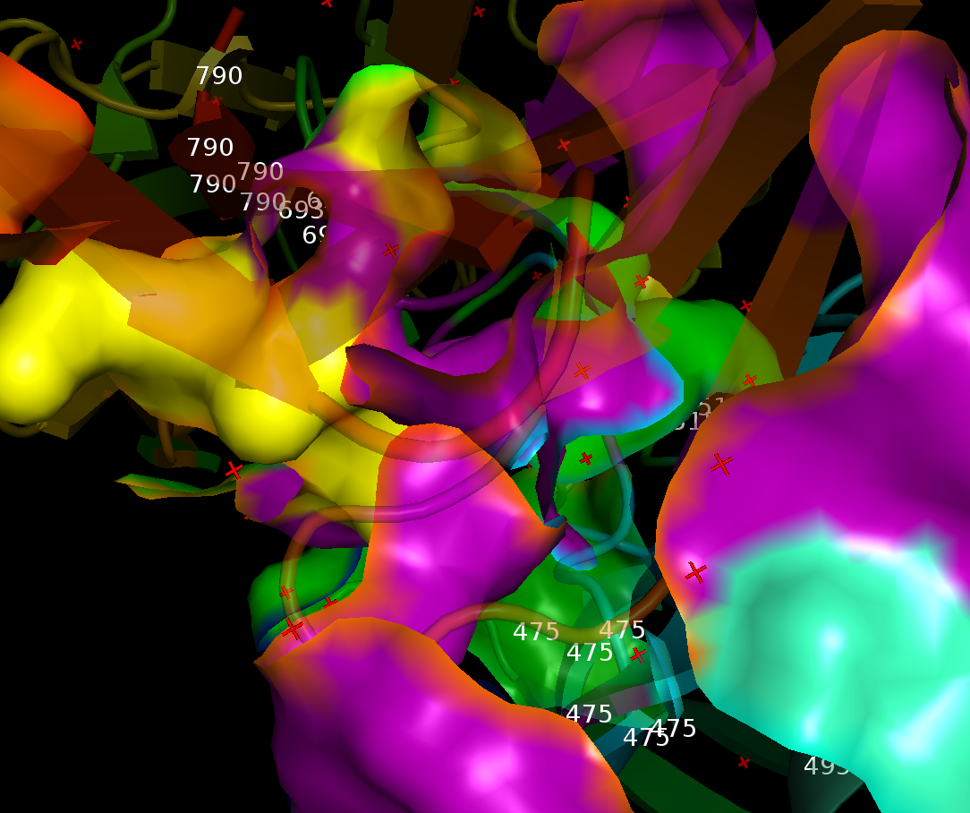
Functional Regions: Clearer Color Display
Domain | Function | Color
N3-B loop | latch to enclose the captured ligand by intruding into the space between beta-strands E and D and completing beta-sheets formation in the first N domain | yellow
N2-N3 interface | cleavage | green
N2-B interface |  | purple
B loop stabilized by K |  | orange
N2 | Forming the latch pocket | greencyan
Notes:
Change to stick to characterize the AA heavy atoms

Slide 7
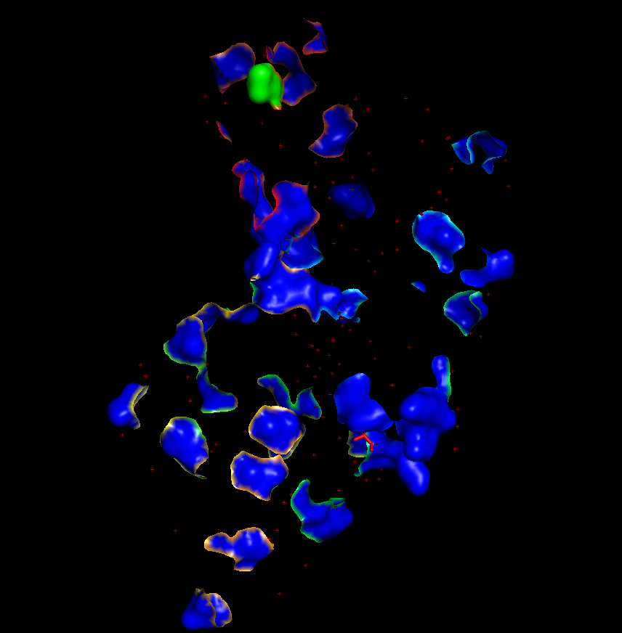
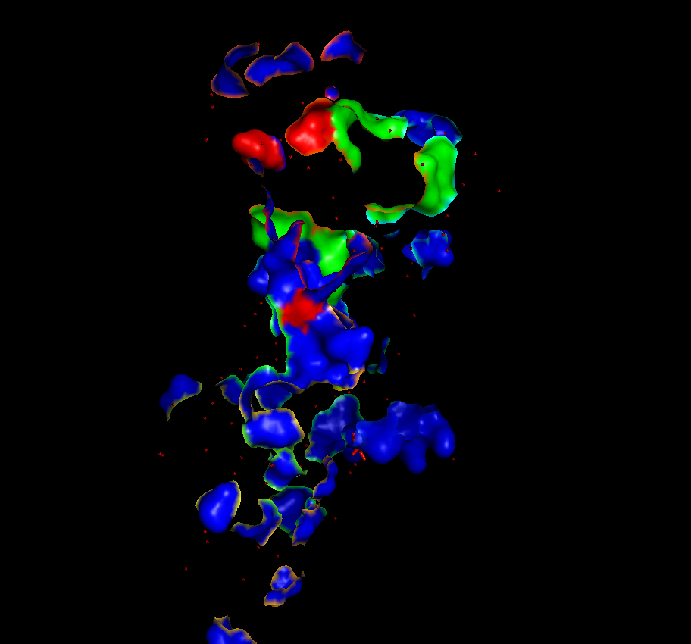
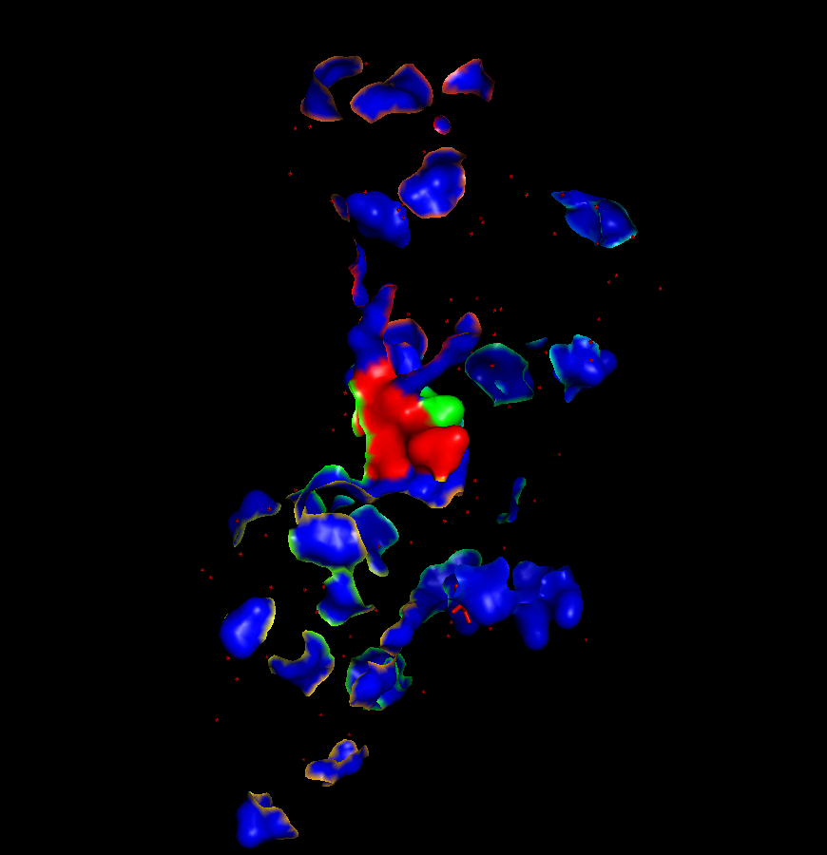
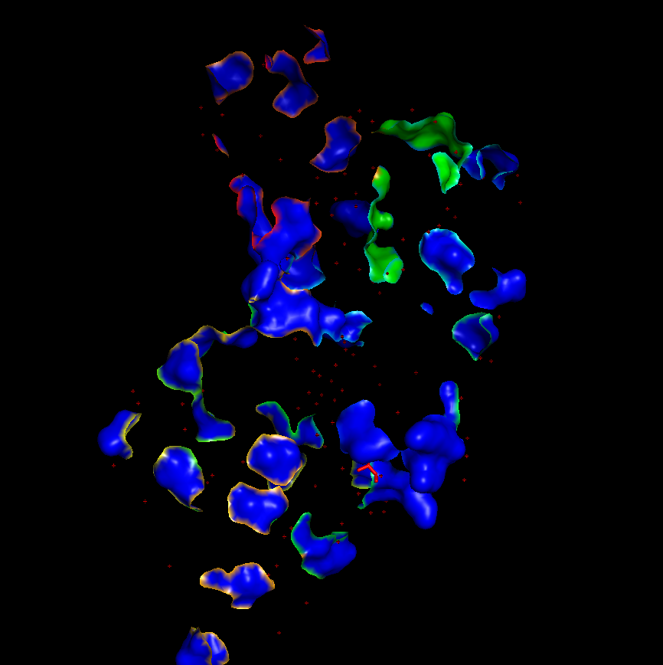
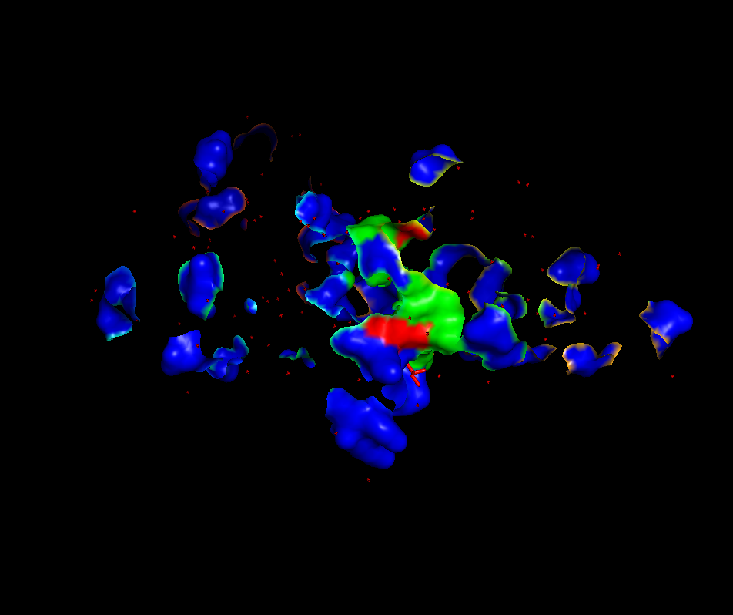
Superimpose all mutated sites with each of the functional region
B loop stabilized by K
N2-B interface
May generate for each haplotype
Evolution perspective:
If one cluster contains specific functional ‘’
Recombination between strains are in the projected functional region are transform into s genomic background
N3-B loop
Latch motif
N2-N3 interface
Notes:
More inN3-B
More conserved in the latch motif
Look into the N3-B interface mutation
Nomenclature

Slide 8
SQLite Demo and collected results

Slide 9
hap_func_match
Parse information from the alignment text file
Store the mutated sites and the mutated sites corresponding to each annotated region type
Mainly use as a cache for further analysis

Slide 10
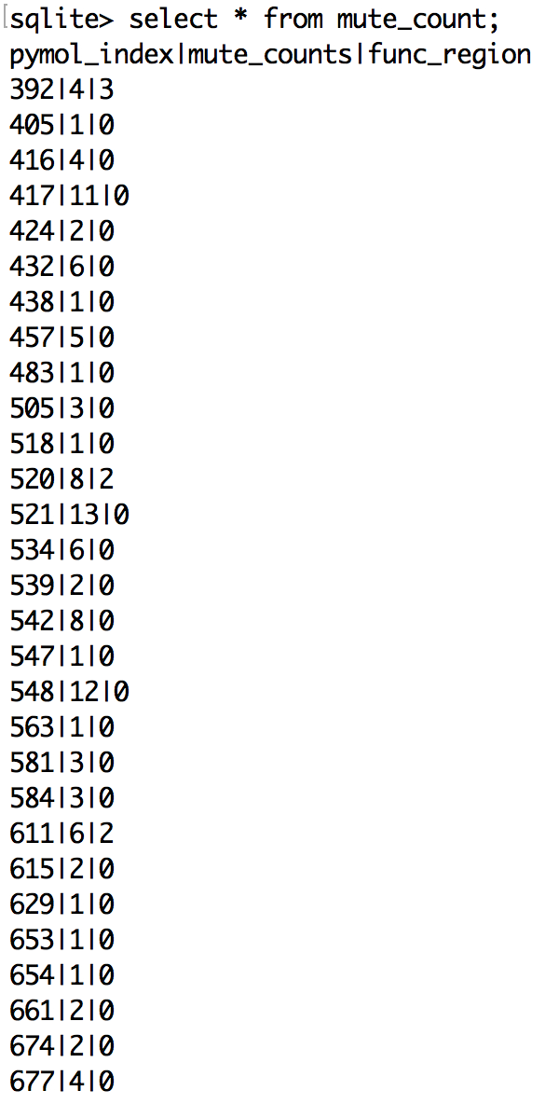
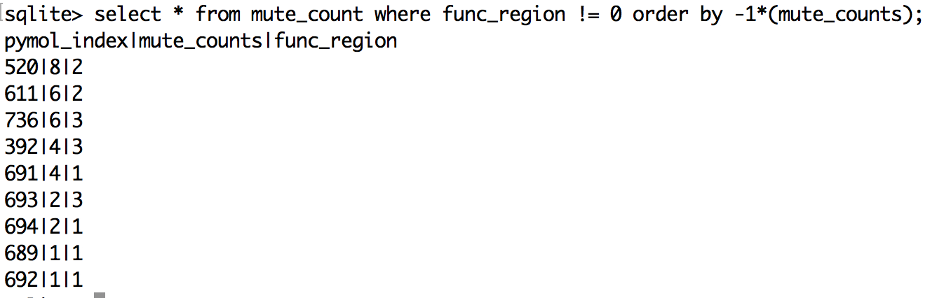
Mute_count
Which site/region has the most frequent change

Slide 11
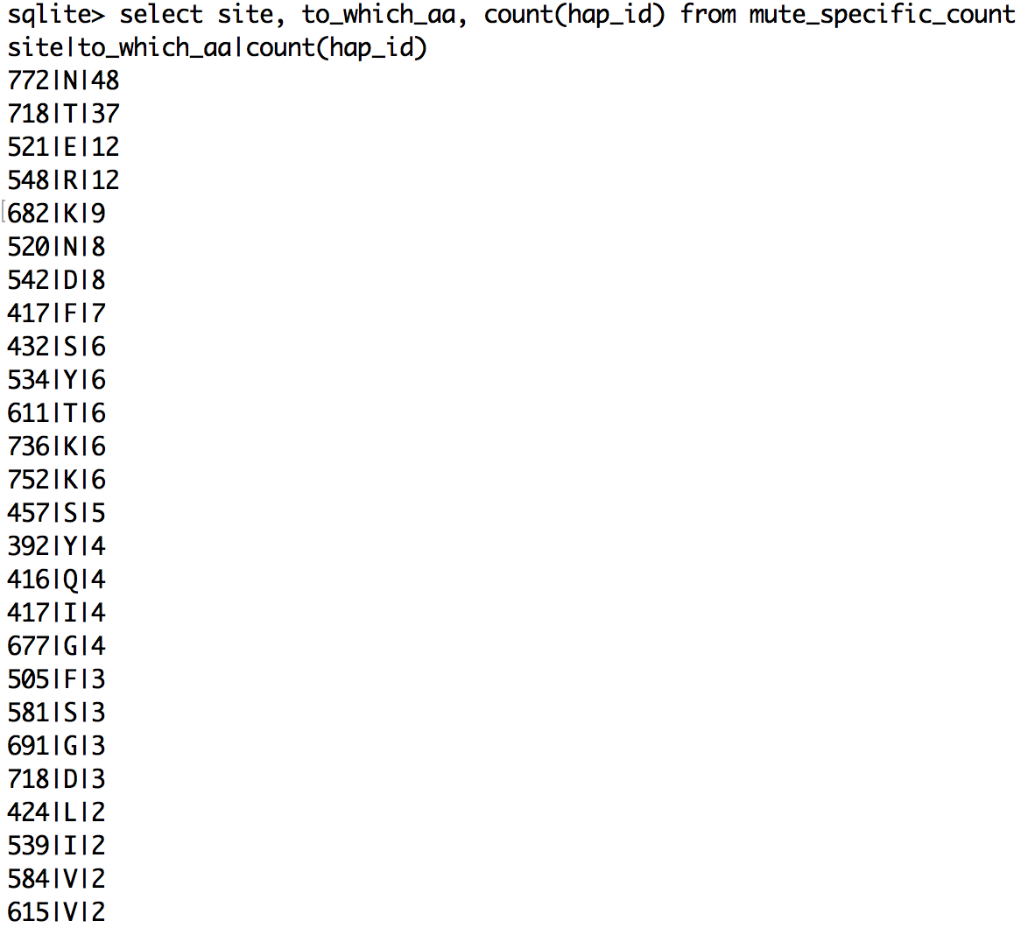
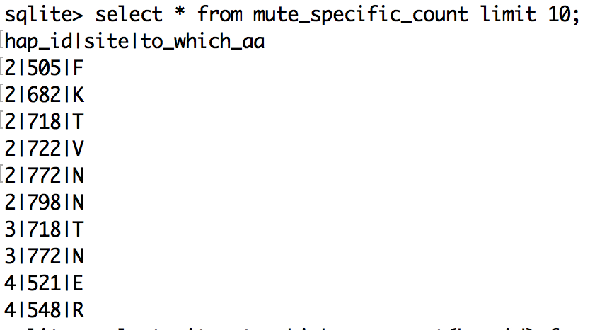
Mute_specific_count
Which site-AA pair has the highest rate of change (should incorporate the annotated region)

Slide 12
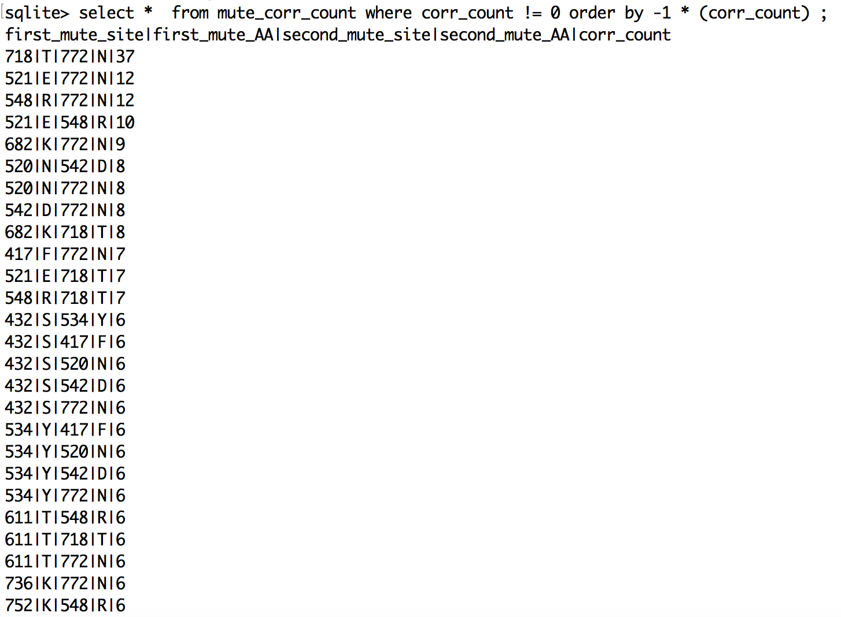
mute_corr_count
Take the counts from the correlation count matrix
Show how pairs of mutation interact
(region annotation should be added)
Some of the correlation exceed word = 2 and should be further aligned (e.g 521, 548, 772)--find the longest connected correlated subsets
Notes:
Normalize the frequency of each of the mutation to normalize the
Some of those may be connected by evolution
Split trees :
Phylogeny, take recomination into account
Linked mutation pair-wise combination

Slide 13
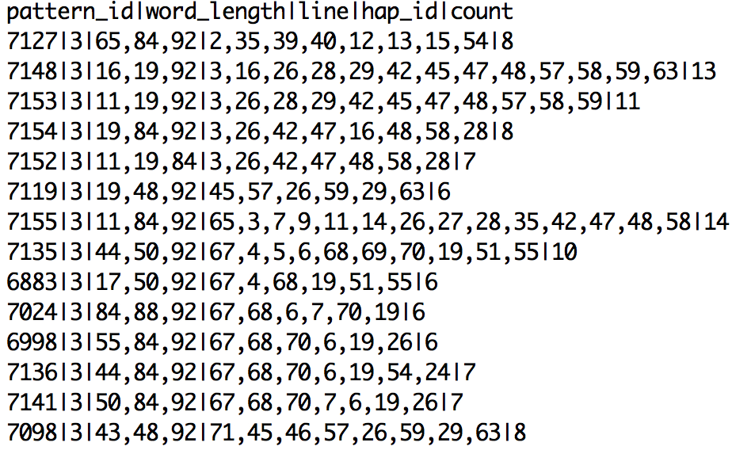
Common “long” correlated sites
1.[29,43,48,30,92]
2.[11,16,19,65,84,92]
3.[35,50,55,84,88,92]
4.[44, 50, 87, 92]
From the mute_corr_count_2

Slide 14
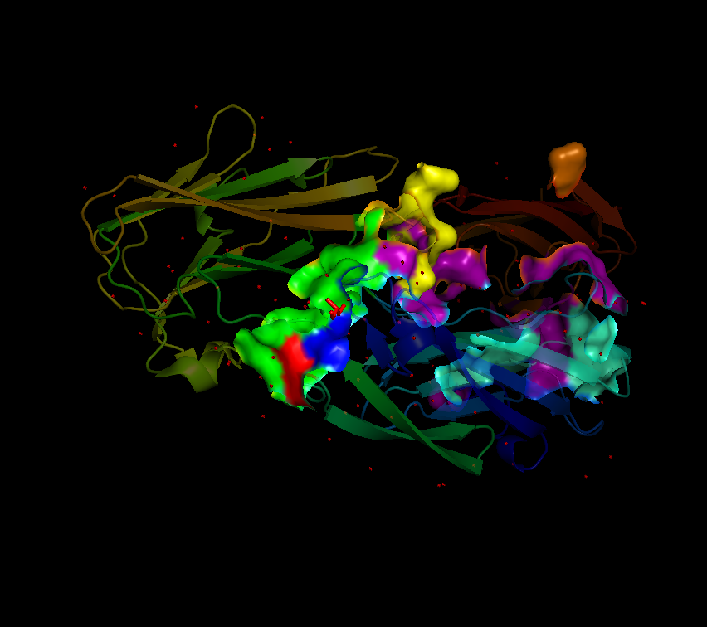
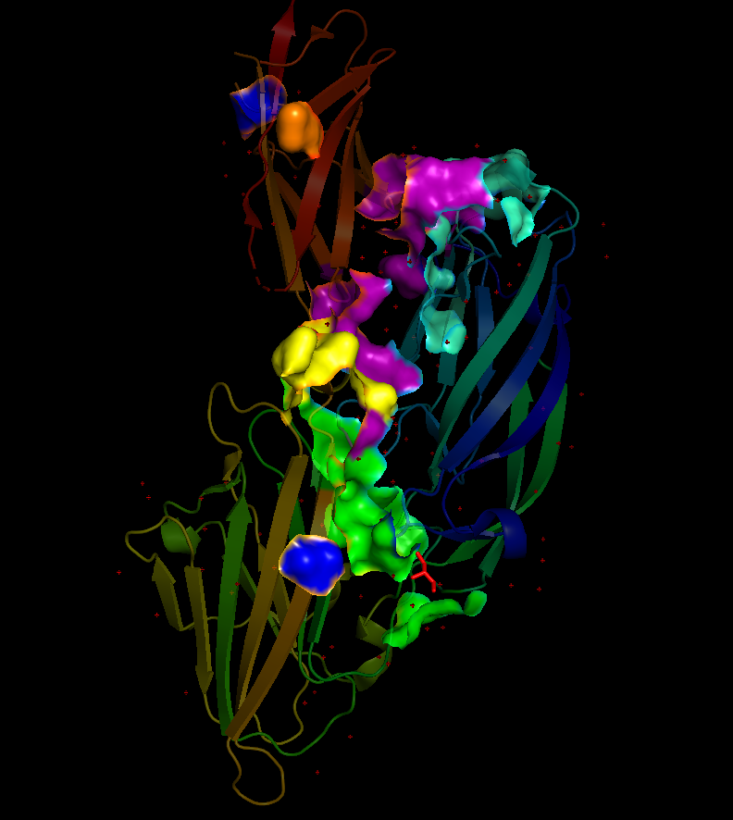
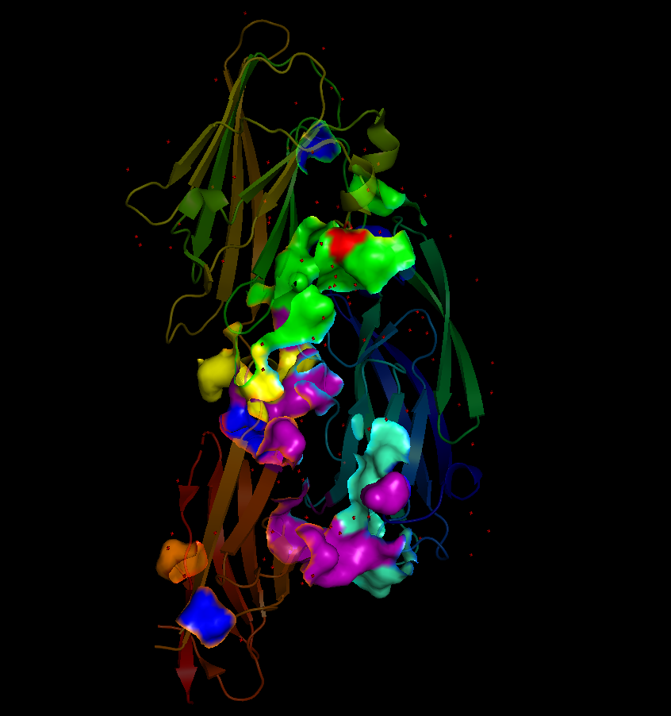
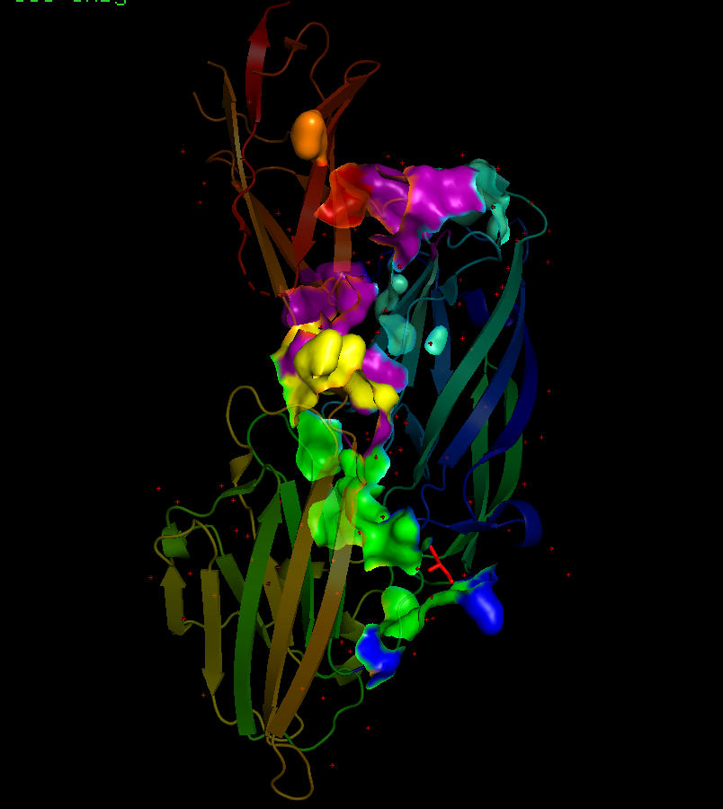
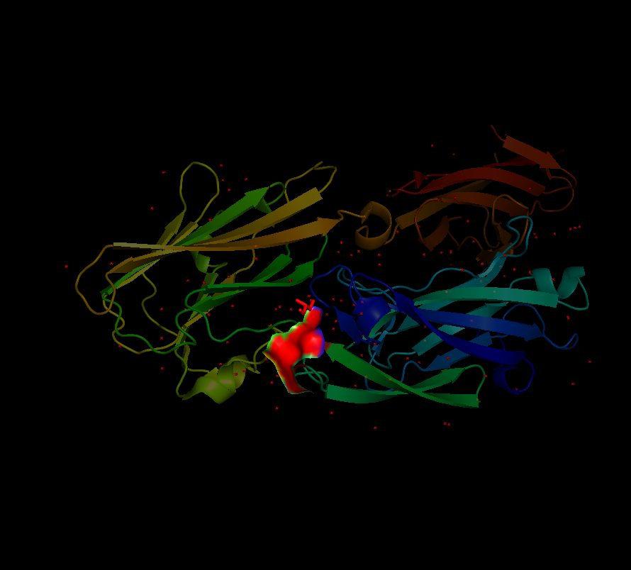
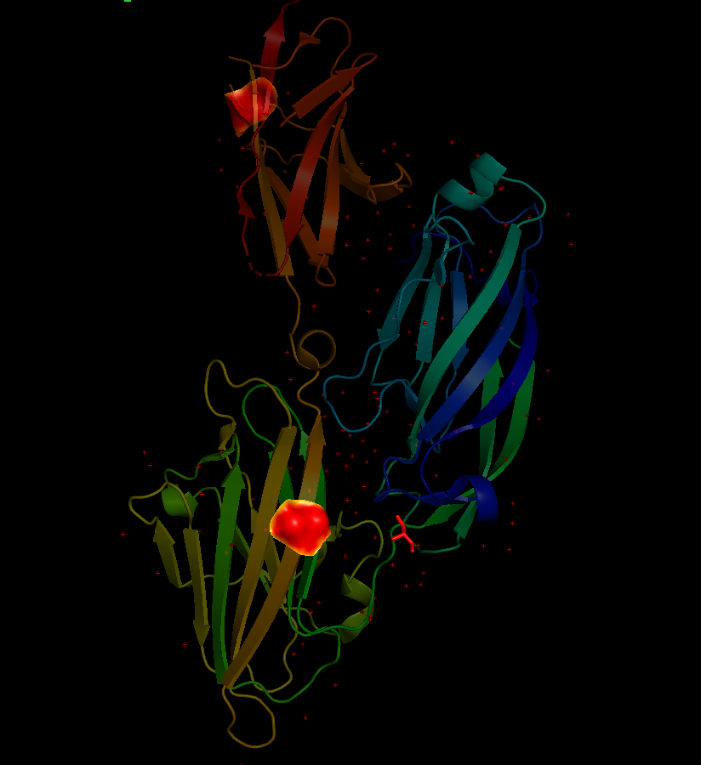
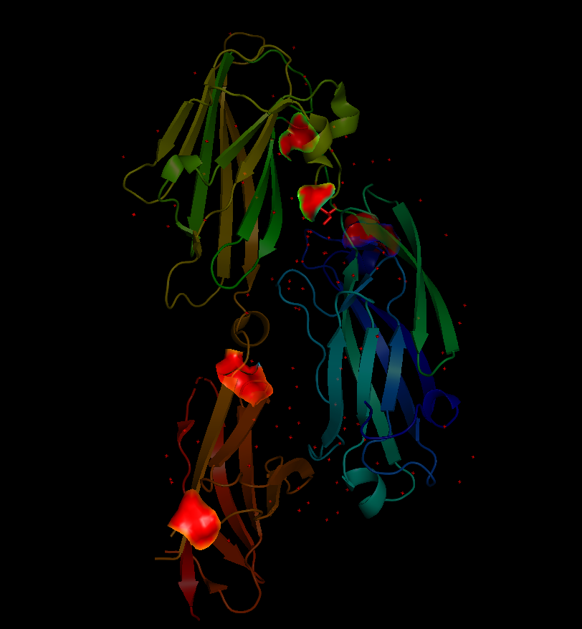
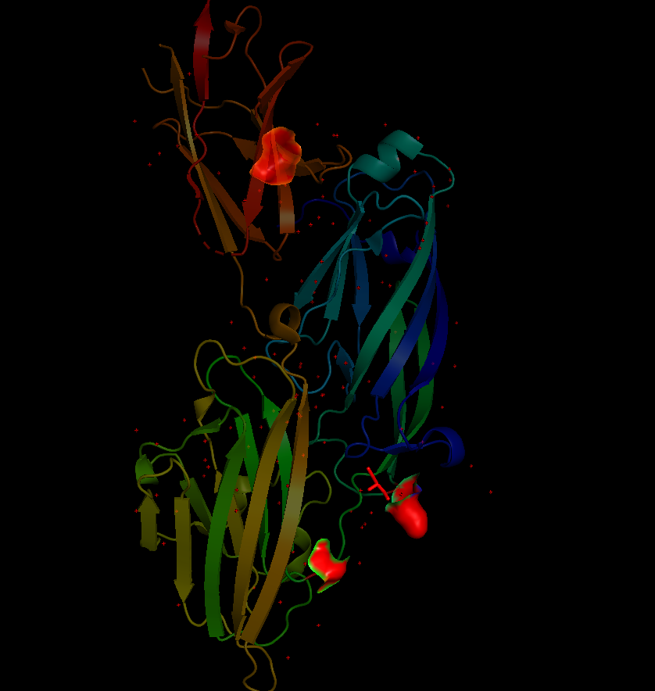
Adjacency Plot
Domain | Color
N3-B loop | yellow
N2-N3 interface | green
N2-B interface | purple
B loop stabilized by K | orange
N2 | greencyan
non-overlap | blue
overlap | red
Notes:
Bin by the actual mutation and the average distance
Stick the spatial relationship distance into the
Split up the interface, use the N1 region to answer the N1

Slide 15
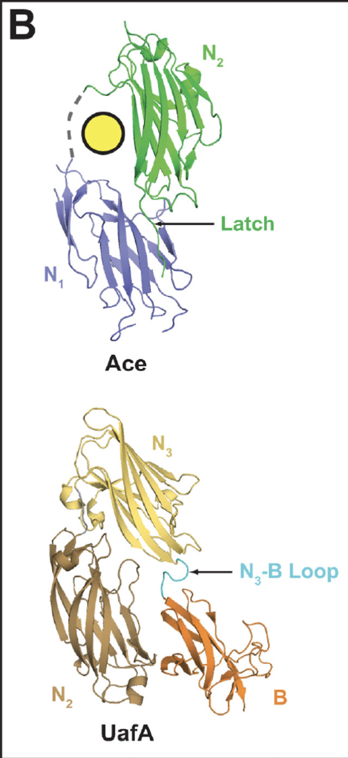
N1 Region structure prediction
Notes:
The loop connecting the N3 and B domains (cyan) is thought to insert into the N2 subdomain upon ligand binding to form a latch.
The N3 subdomain is composed of two β-sheets with a total of nine β-strands in the configuration of A, B, D, E and C, D1, D2, F and G (313). The N2 subdomain contains two similar β-sheets, but sheet 2 lacks a D β-strand and in its place exists a D loop, which does not appear to hydrogen bond with the adjacent E strand. The dock, lock and latch model proposes that in the apo form of the complex, the ligand is first captured by binding between the N2 and N3 subdomains. This docking event then triggers a conformational change to engage the loop connecting the N3 subdomain and the B domain (Fig. 7B), causing the loop to insert into the pocket between the D and E β-strands of the N2 domain, completing the missing β-strand and forming the “latch”

Slide 16
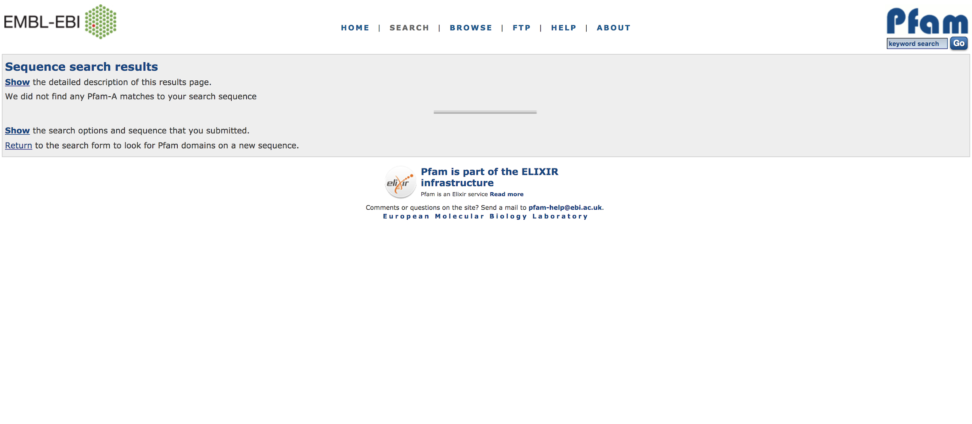
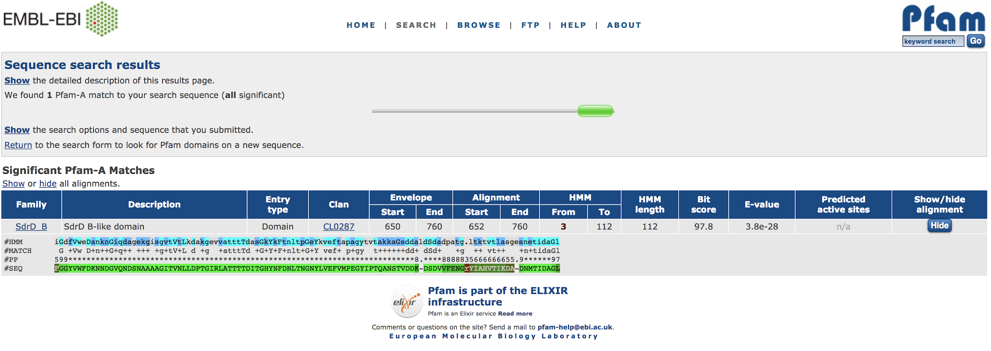
Pfam
Notes:
No results for N1 solely
And an alignment with SdrD B domain with the full sequence (not N1)

Slide 17
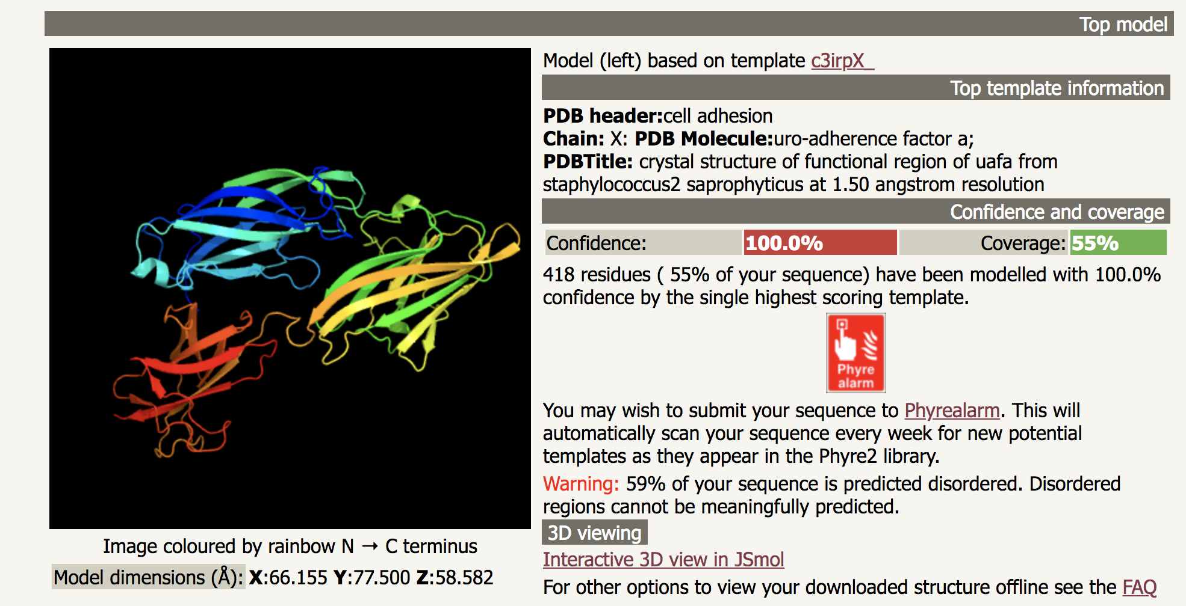
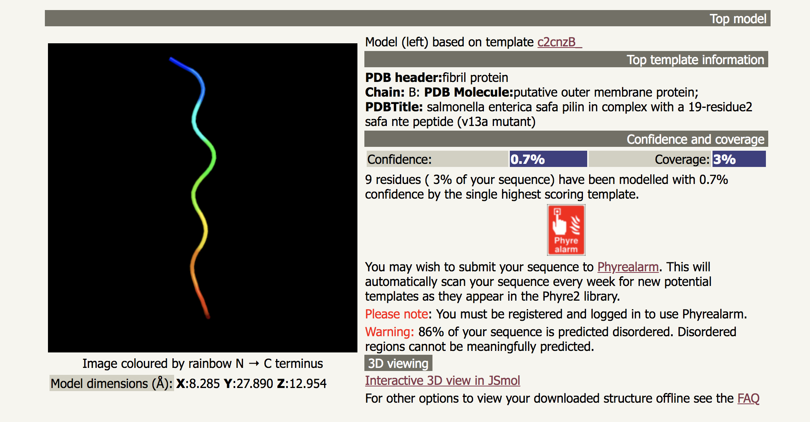
Phyre2

Slide 18
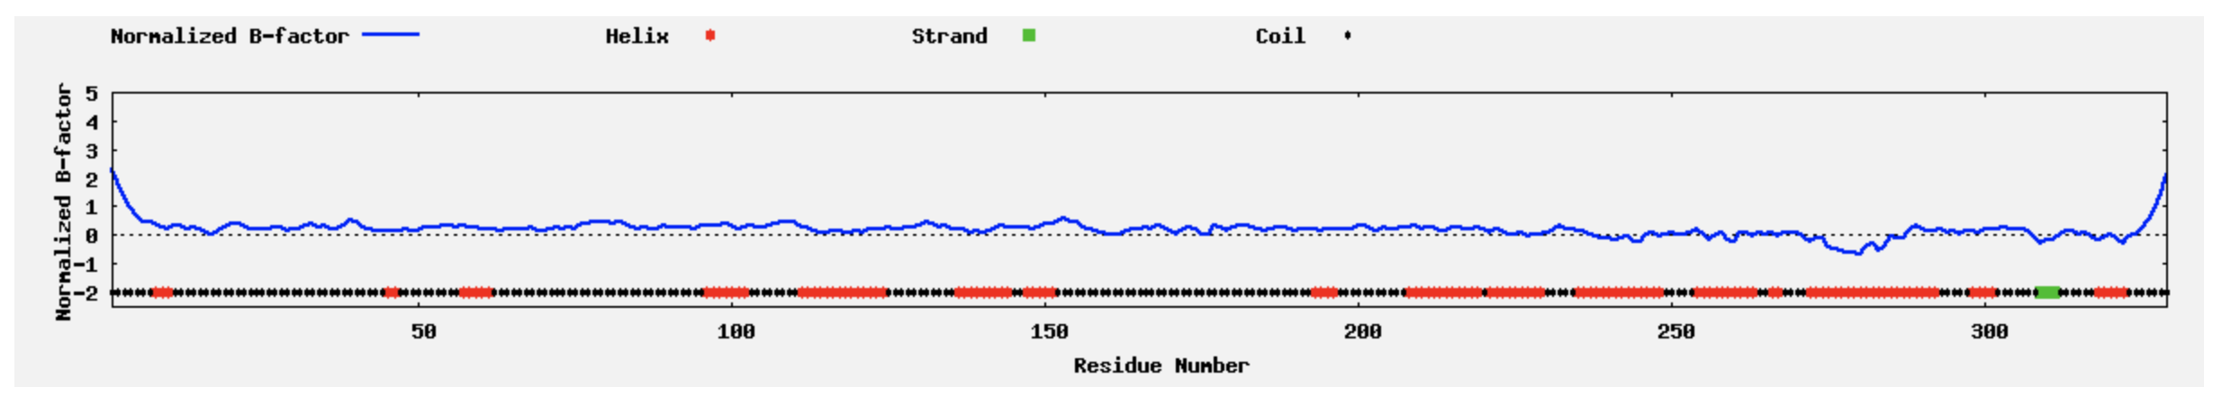
I-TASSER
https://zhanglab.ccmb.med.umich.edu/I-TASSER/output/S403704/
https://zhanglab.ccmb.med.umich.edu/I-TASSER/output/S404019/
Residues with BFP values higher than 0 are less stable in experimental structures.
Notes:
(For each target, I-TASSER simulations generate a large ensemble of structural conformations, called decoys. To select the final models, I-TASSER uses the SPICKER program to cluster all the decoys based on the pair-wise structure similarity, and reports up to five models which corresponds to the five largest structure clusters.
The confidence of each model is quantitatively measured by C-score that is calculated based on the significance of threading template alignments and the convergence parameters of the structure assembly simulations. C-score is typically in the range of [-5, 2], where a C-score of a higher value signifies a model with a higher confidence and vice-versa.
TM-score and RMSD are estimated based on C-score and protein length following the correlation observed between these qualities. Since the top 5 models are ranked by the cluster size, it is possible that the lower-rank models have a higher C-score in rare cases. Although the first model has a better quality in most cases, it is also possible that the lower-rank models have a better quality than the higher-rank models as seen in our benchmark tests. If the I-TASSER simulations converge, it is possible to have less than 5 clusters generated; this is usually an indication that the models have a good quality because of the converged simulations.
(After the structure assembly simulation, I-TASSER uses the TM-align structural alignment program to match the first I-TASSER model to all structures in the PDB library. This section reports the top 10 proteins from the PDB that have the closest structural similarity, i.e. the highest TM-score, to the predicted I-TASSER model. Due to the structural similarity, these proteins often have similar function to the target. However, users are encouraged to use the data in the next section 'Predicted function using COACH' to infer the function of the target protein, since COACH has been extensively trained to derive biological functions from multi-source of sequence and structure features which has on average a higher accuracy than the function annotations derived only from the global structure comparison.)
1. How was the local accuracy estimated?
The local accuracy was defined as the distance deviation (in Angstrom) between residue positions
in the model and the native structure. It was estimated using support vector regression that makes
use of the coverage of threading alignment, divergence of I-TASSER simulation decoys, and
sequence-based secondary structure and solvent accessibility predictions. Large-scale benchmark
tests show that the estimated local accuracy has an average error of 2.21 Angstrom and the
Pearson's correlation coefficient between estimated and actual error is 0.7.
Based on these tests, the local accuracy estimations tend to be more accurate for residues:
1) that have higher threading alignment coverage
2) that are located at alpha-helix and beta-strand regions
3) that are buried (at 25% threshold)
The estimated local accuracy for each model is available at the columns 61-66 in the model's PDB file
and also at the bottom of this page (columns with label RSQ_*).
2. What is normalized B-factor?
Normalized B-factor for a target protein is defined as z-score-based normalization of the
raw B-factor values. The normalized B-factor (called B-factor profile, BFP) is predicted using a
combination of both template-based assignment and profile-based prediction. Based on the distributions
and predictions of the BFP, residues with BFP values higher than 0 are less stable in experimental
structures. The estimated normalized B-factor is shown at the bottom of this page.
C-score is a confidence score for estimating the quality of predicted models by I-TASSER. It is calculated
based on the significance of threading template alignments and the convergence parameters of the structure
assembly simulations. C-score is typically in the range of [-5,2], where a C-score of higher value signifies
a model with a high confidence and vice-versa.
TM-score and RMSD are known standards for measuring structural similarity between two structures which are usually used to measure the accuracy of structure modeling when the native structure is known. In case where the native structure is not known, it becomes necessary to predict the quality of the modeling prediction, i.e. what is the distance between the predicted model and the native structures? To answer this question, we tried predicted the TM-score and RMSD of the predicted models relative the native structures based on the C-score.
In a benchmark test set of 500 non-homologous proteins, we found that C-score is highly correlated with TM-score and RMSD. Correlation coefficient of C-score of the first model with TM-score to the native structure is 0.91, while the coefficient of C-score with RMSD to the native structure is 0.75. These data actually lay the base for the reliable prediction of the TM-score and RMSD using C-score. Values reported in Column 3 & 4 are the estimated values of TM-score and RMSD based on their correlation with C-score. Here we only report the quality prediction (TM-score and RMSD) for the first model, because we found that the correlation between C-score and TM-score is weak for lower rank models. However, we list the C-score of all models just for a reference.
What is TM-score?
TM-score is a recently proposed scale for measuring the structural similarity between two structures (see Zhang and Skolnick, Scoring function for automated assessment of protein structure template quality, Proteins, 2004 57: 702-710). The purpose of proposing TM-score is to solve the problem of RMSD which is sensitive to the local error. Because RMSD is an average distance of all residue pairs in two structures, a local error (e.g. a misorientation of the tail) will araise a big RMSD value although the global topology is correct. In TM-score, however, the small distance is weighted stronger than the big distance which makes the score insensitive to the local modeling error. A TM-score >0.5 indicates a model of correct topology and a TM-score<0.17 means a random similarity. These cutoff does not depends on the protein length.
What is Cluster density?
I-TASSER generates full length model of proteins by excising continuous fragments from threading alignments and then reassembling them using replica-exchanged Monte Carlo simulations. Low temperature replicas (decoys) generated during the simulation are clustered by SPICKER and top five cluster centroids are selected for generating full atomic models. The cluster density is defined as the number of structure decoys at an unit of space in the SPICKER cluster. A higher cluster density means the structure occurs more often in the simulation trajectory and therefore signifies a better quality model. The values in the second last columns of the above mentioned table repesents the number of structural decoys that are used in generating each model. The last column represents the density of cluster.

Slide 19
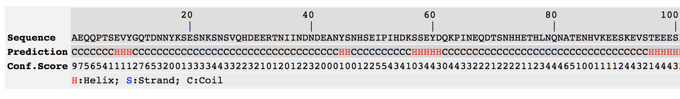
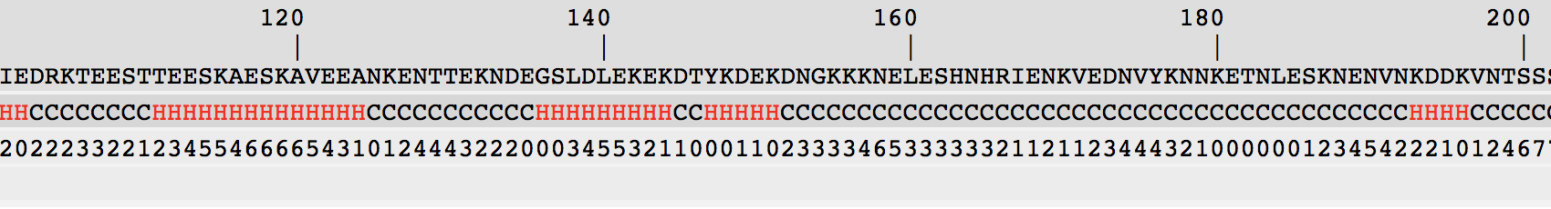
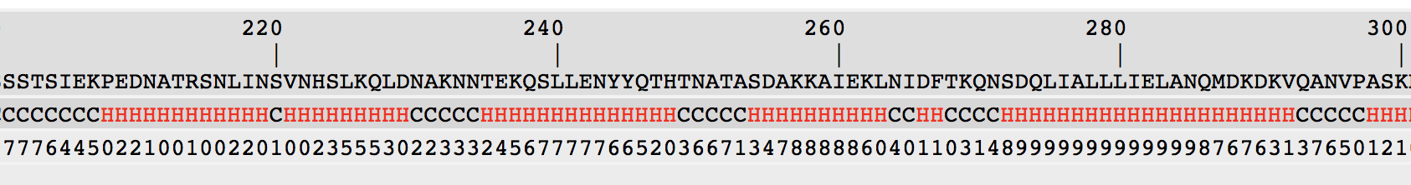
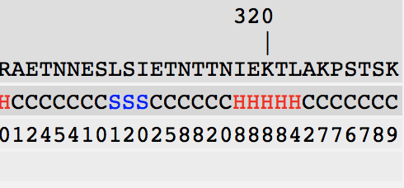

Slide 20
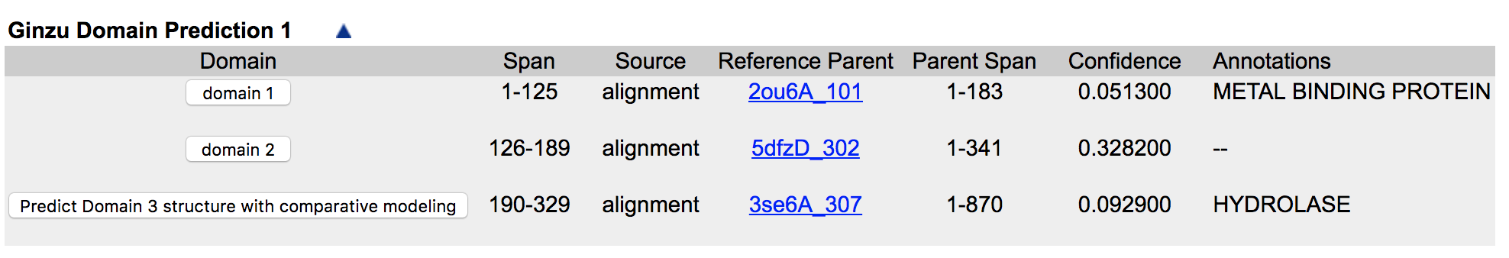
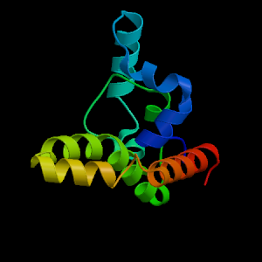
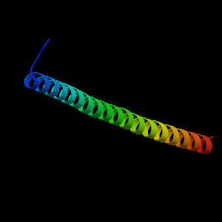
Robetta - N1 ONLY
http://robetta.bakerlab.org/results.jsp?id=84088
No Signal Peptide as expected
92% predicted as disordered
Align to the original pdb entry

Slide 21
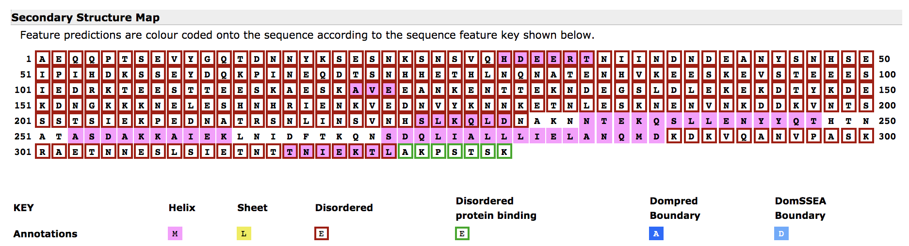
psipred Results
Notes:
N1 domain origin

Slide 22
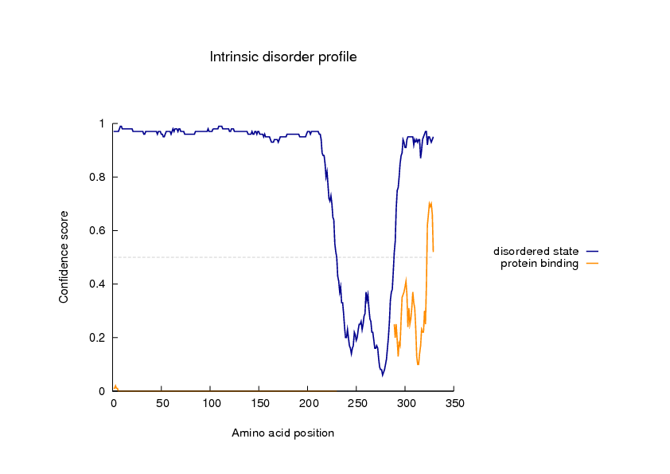

Slide 23
AAS Bioinformatics tools

Slide 24
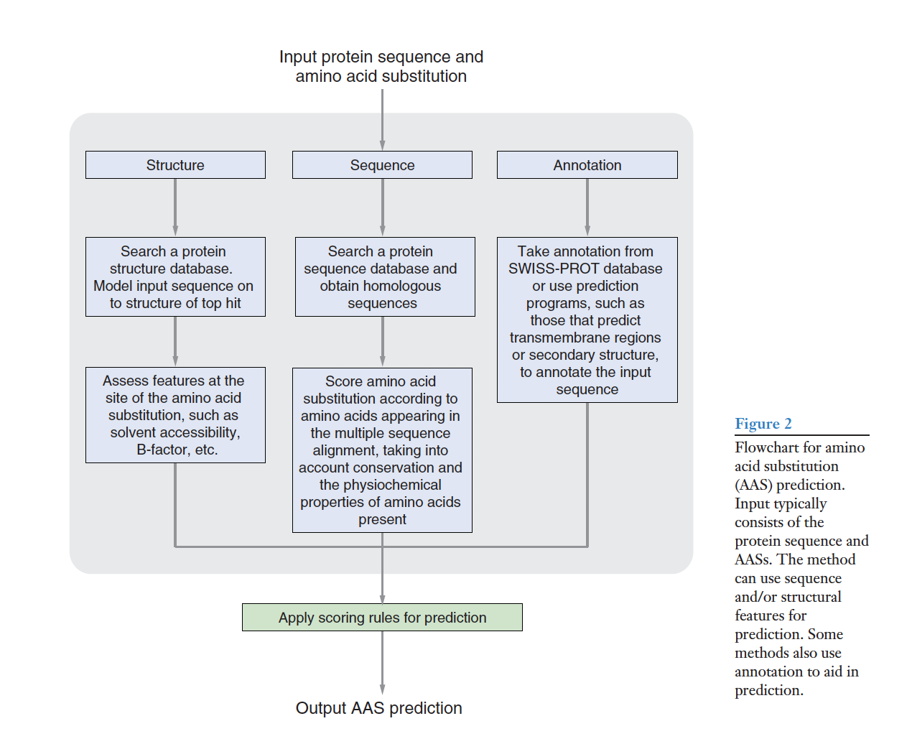
From Henikoff Review

Slide 25
General Types
Schaefer and Rost 2012; Livingstone 2014: Different structural and biochemical propensities:
Mass, volume, hydrophobicity, C-beta branching, electric charge on side chain
Secondary structure, solvent accessibility, protein flexibility, protein disorder
I-mutant3 and SNAP reflect reliability of the prediction
Henikoff Review; Quan, Zhang 2016： Strum combine 3 different aspects and run multiple algorithms to train the model
stability: △G = G(unfold) - G(fold): The higher and more positive △G, the more stable， △△G = △G(Mut) - △G(WT)
Sequence-based: SIFT/INPS
Structural based; I-mutant, PoPMuSiC, ProMaya, NeEMO. mCSM

Slide 26
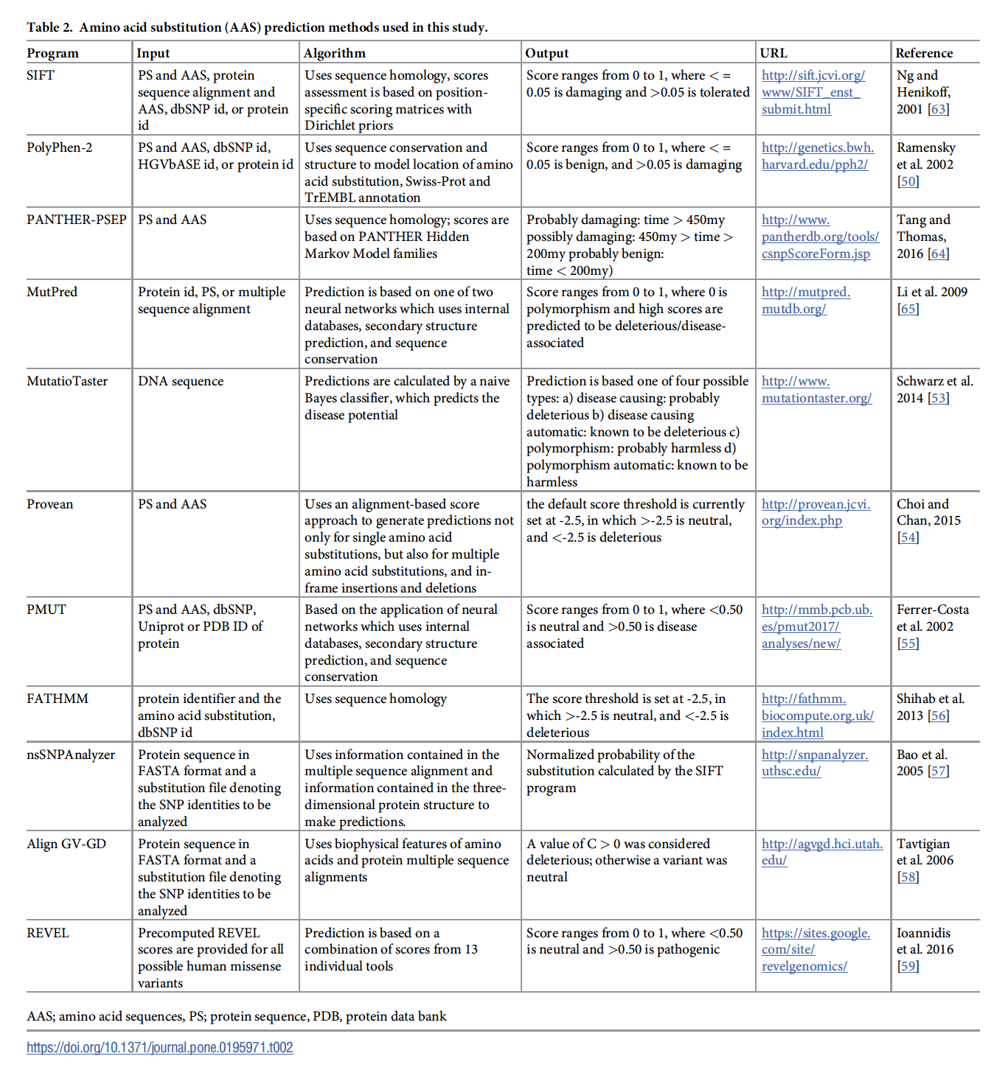
Selected for further output (Seifi 2018)
Question: dbSNPid?
Need DNA

Slide 27
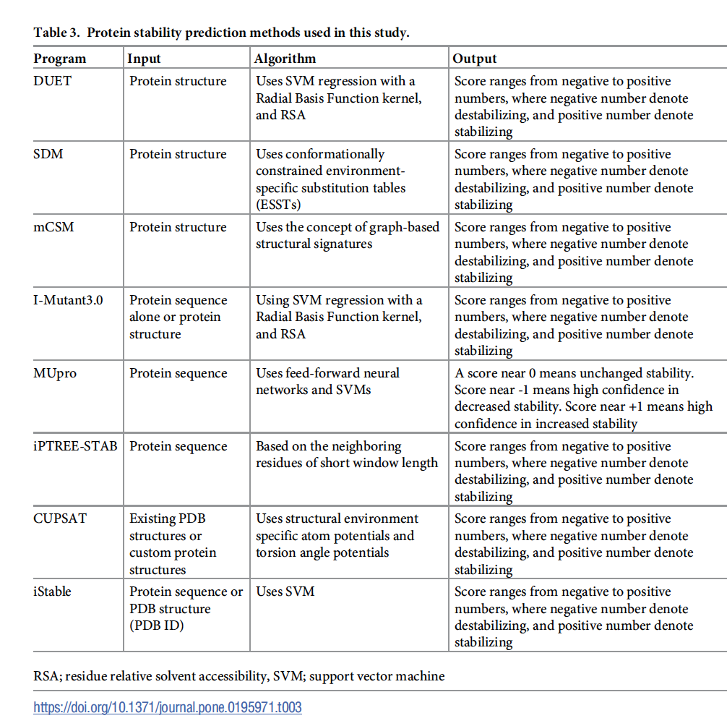
PROTEIN STABILITY
in this study, all variations were classified as predicted to be neutral (-1.5 <
ΔΔ G < 1.5), stabilizing (ΔΔ G > 1.5) or destabilizing (ΔΔ G < -1.5).

Slide 28
Attempt on DUET
S772N no secondary structure assigned
A718T -0.779 Kcal/mol (Destabilizing)
K521E 0.116 Kcal/mol (Stabilizing)
V548R -0.772 Kcal/mol (Destabilizing)
A682K -0.725 Kcal/mol (Destabilizing)
D520N -0.511 Kcal/mol (Destabilizing)
Still within the neutral (-1.5 <
ΔΔ G < 1.5) region

Slide 29
NOTES
Generate the superimposition of the each haplotype with each annotated regions
Both picture and charts for inspection
267 sequences in total
Additional sequences on genomic information
Find other N1 domains and try to blast (against everything )whether
Staphylo..
A more statistical approach : with the division of the total count and also the physical distance calculation
Probability of the (AA1 with AA2)/(pAA1)(pAA2)
They correlate the ones with the distance

